Slide 1
擴展國際市埸 Develop International Business
周德麟
副總裁級
Field Vice President
四個佣金週期共賺取HK$276,000
HK$276,000 in 4 Commission weeks
本簡報中提到的收入等級純屬舉例說明，無意代表美安香港超連鎖店主的一般收入，也無意表示任何超連鎖店主皆可賺取同等收入。美安香港超連鎖店主的成功與否，取決於其在發展事業時的努力、才能與投入程度。The income levels mentioned in the following presentation are for illustration purposes only. They are not intended to represent the income of a typical Market Hong Kong UnFranchise Owner, nor are they intended to represent that any given Independent UnFranchise Owner will earn income in that amount. The success of any Market Hong Kong Independent UnFranchise Owner will depend upon the amount of hard work, talent, and dedication which he or she devotes to building his or her Market Hong Kong Business.

Slide 2
美安-全球性跨國企業
MA – A multinational enterprise
人人都可開拓經營國際市場
An international market that everyone can develop

Slide 3
Asia Pacific Region 亞太區域
Australia 澳洲
Taiwan 台灣
Hong Kong 香港
Singapore 新加坡
New Zealand新西蘭(EMP)

Slide 4
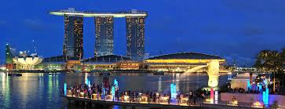
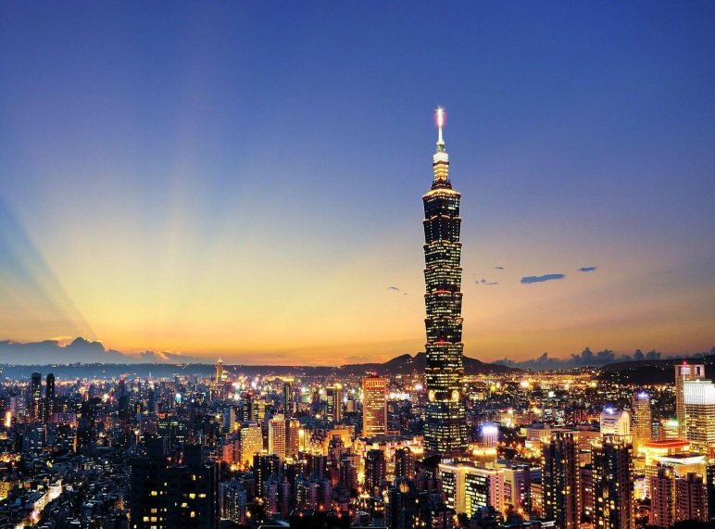
雪梨 Sydney
香港 Hong Kong
新加坡 Singapore
台北 Taipei

Slide 5
Los Angeles 洛杉磯
New York 紐約
Vancouver 溫哥華
Toronto 多倫多
London 倫敦
Barcelona 巴塞隆拿
Shanghai 上海
Beijing 北京
Rome 羅馬
Paris 巴黎......
全球充滿特色風味城市
The cities are rich in different cultures

Slide 6
國際市場的特點 The characteristics of the international business
優勢Advantages
需求量大 Huge demand
競爭較少 Less competion
能快成長 Fast growth
市場尚未被開發The market has yet to be developed

Slide 7
亞洲BV/IBV一體化的威力! The power of Asia-Pacific Unification
5000 / 5000 BV
001
hk1
hk2
HK 3000 BV
hk3
TW 4000 BV
tw1
hk4
hk5
tw2
tw3
AU 2000 BV
tw4
au1
au2
au3
tw5
tw6
au4
SG 1000 BV
hk6
au5
au6
hk7
hk8

Slide 8
國際團隊與本地團隊有何不同 ? The differences between international team and local team
時空不同 - 見面不易 互動基礎
文化不同 - 語言 思想 習慣
Different places – hard to meet, interaction
Different cultures – languages, mindsets, habits

Slide 9
國際市場可行性自我評估
The self assessment of international business feasibility
市場特性Market characteristics
團隊實力The strength of your team
自己實力The strength of your own
獨立作業的能力Independent ability -- 1-1 / HBP / NUOT, B5, ECCT訓練,帶組織
自我調適能力Self adjustment ability-- 距離遠,有時差,金錢投資大/時間長,初期無全國聯盟會議系统 Long distance, time different, huge money/time investment, without NMTSS at the beginning

Slide 10
擴展國際市埸的啟動方式
How to Start the International Business Development
從本地/本國開始 Start from your own market
人脈及早舖路 - 社群媒體/各式组織
Network-social media/different organizations
團隊協商及規畫啟動計畫 Team negotiation and set the started plan
企業家/老闆心態 -肯付代價, 體力/心力/財力
Entrepreneur attitude - willing to pay effort and money

Slide 11
擴展國際市埸 Develop International Business
本國/本地有持續發展及規畫最重要
Has local sustainable development and planning
本國/本地要有領導人留守, 不可捨本逐末Local leaders should stay, cannot forget the original purpose

Slide 12
國際團隊組織發展策略
The Strategy of International Team Development
培養領袖 Leadership Training
建立團隊互助 Cross-team
帶入NMTSS系統 Get into the NMTSS System

Slide 13
培養領袖Leadership Training
發掘/培養要成功的人Explore / cultivate to succeed
成功的習慣 - 專注目標、積極正面、感恩Successful habits – stay focus, be positive and grateful
善用現代科技- 掌握團隊動向/生態
- Email / 電話 / Line / WhatsApp/WeChat/Skype跟進 Leaders
Leverage the modern technology to master the trend of team
- Email, telephone, Line, Whatsapp, WeChat, Skype

Slide 14
建立團隊互助 Cross-team
當地-上下線 /友線合作，成立地方核心
Local: cooperation with up and down/ other lines to build a local core
外地-上下線 /友線, 輪流支援/培訓
Overseas: up and down/ other lines provide support and trainings
團隊配搭/合作的氣度, 招募/培訓/帶組織
The teams with the cooperation of tolerance, recruitment / training / leading organization
沒有完美的個人，只有完美的團隊！
There is no perfect man but perfect team!

Slide 15
帶入系統 Get into the System
草創期 -培訓產品/公司/制度 Product Training/ Company/ System
Initial stage -打好基本功：一對一、ABC、HBP等
Foundation: 1-1, ABC, HBP
-建立團隊/ 歸屬感 Team and belongingness building NMTSS -参與 NMTSS、NUOT/B5/ECCT、 UBP、
地方研討會 /香港/新加坡/台灣 /美國大會
Participate in NMTSS, NUOT/B5/ECCT, UBP, Local Seminar, HK/SG/TW/US conventions
跟著團隊/系統/公司走
Follow the team, system and company

Slide 16
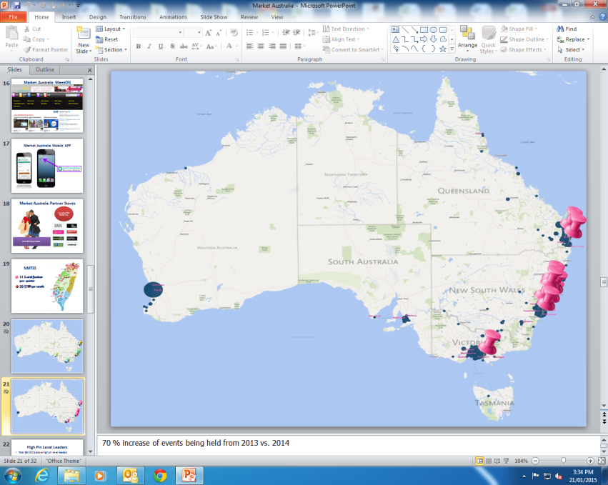
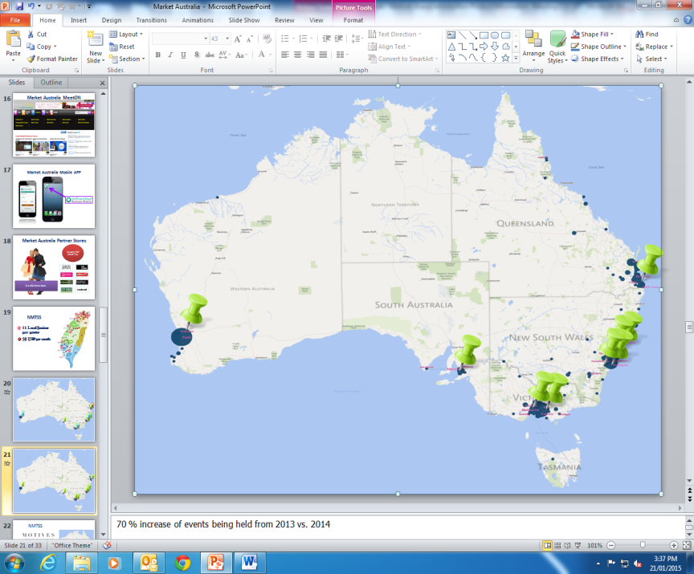
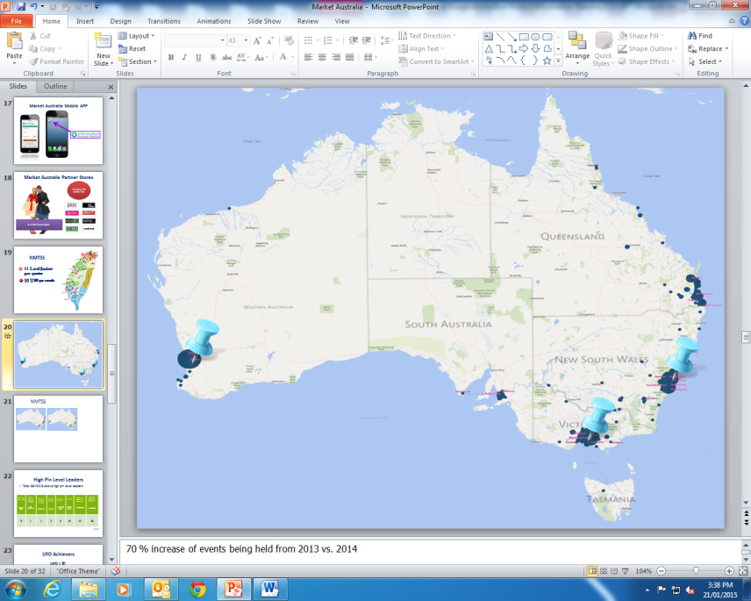
會議聯盟系統訓練NMTSS Training
香港Hong Kong -每月4場UBP 4 UBPs per month
- 一年5場本地研討會5 local seminars per year
- 產品訓練、年會、領袖訓練會議Product Training, Annual Convention and Leadership School
澳洲Australia
每月13場Motives ®訓練13 Motives® Training
per Month
每月9場UBP
9 UBPs per Month
每季3場本地研討會
3 Local Seminars
per Quarter

Slide 17
會議聯盟系統訓練NMTSS Training
台灣 Taiwan
項目Type | 每月Per Month
新超連鎖店主訓練NUOT | 28
超連鎖事業簡報會UBP | 50
本地研討會Local Seminar | 4
成功五要訣Basic 5 | 44
授證經理級訓練ECCT | 30
產品訓練Product Training | 32
網路中心訓練Webcenter Training | 59
Motives® 訓練Motives® Training | 124
TLS® 訓練TLS ®Training | 114

Slide 18
會議聯盟系統訓練NMTSS Training
新加坡 Singapore
項目Type | 次數# of times (Sep – Dec 2014)
超連鎖事業簡報會UBP | 16
新超連鎖店主訓練NUOT | 16
成功五要訣B5 | 5
授證經理級訓練ECCT | 4
本地研討會 Local Seminars | 2

Slide 19
擴展國際市埸成功關鍵 The key to success of international business development
詳細完整規畫Detailed planning
做到：心勤、嘴勤、腳勤 Hard-working
借力當地NMTSS Leveraging the local NMTSS
借力各國大會包含美國世界及國際年會Leveraging the National conventions includes MA World Conference and International Convention

Slide 20
測量、監測、調整、掌控Measurement, monitoring, adjustment, control
行動，行動，再行動
Action, action and action
不斷超越自我，超越挑戰
Keep beyond the self, beyond the challenge

Slide 21
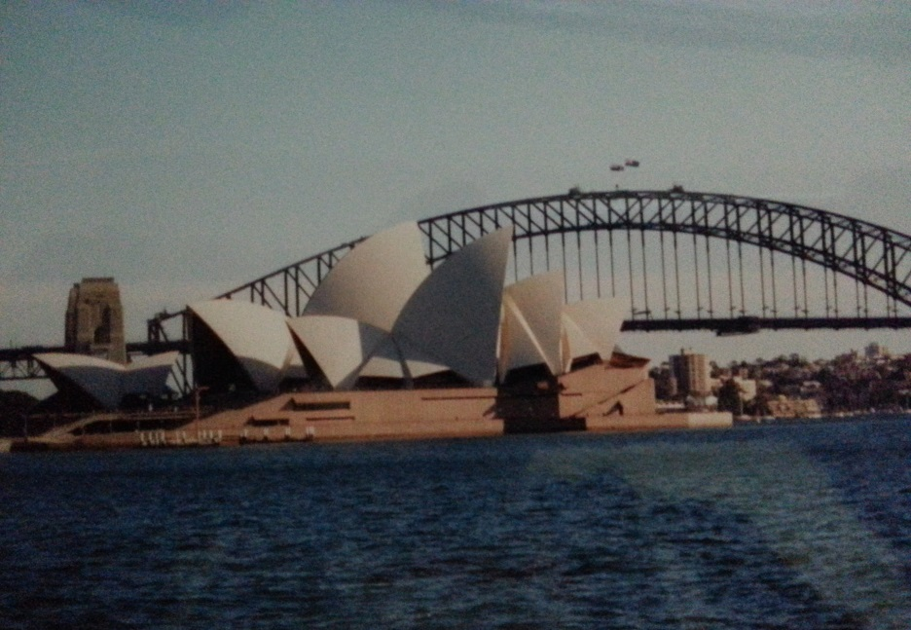
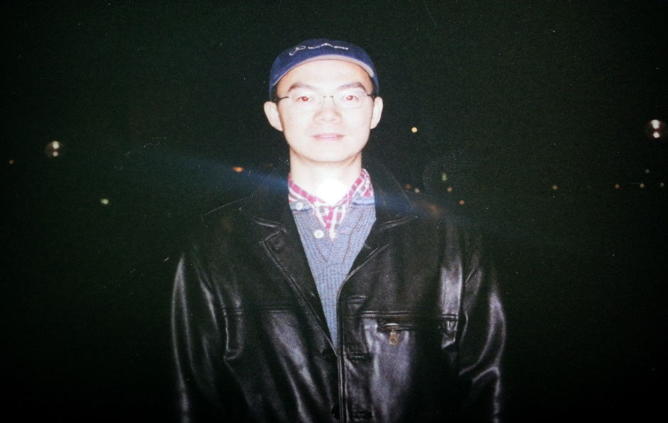
澳洲 Australia

Slide 22
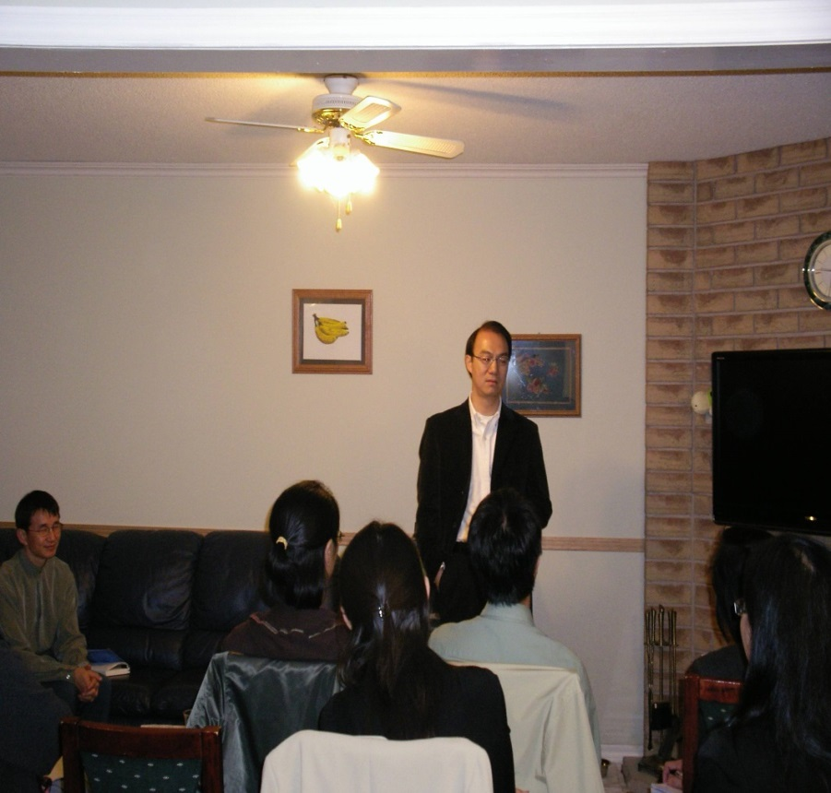
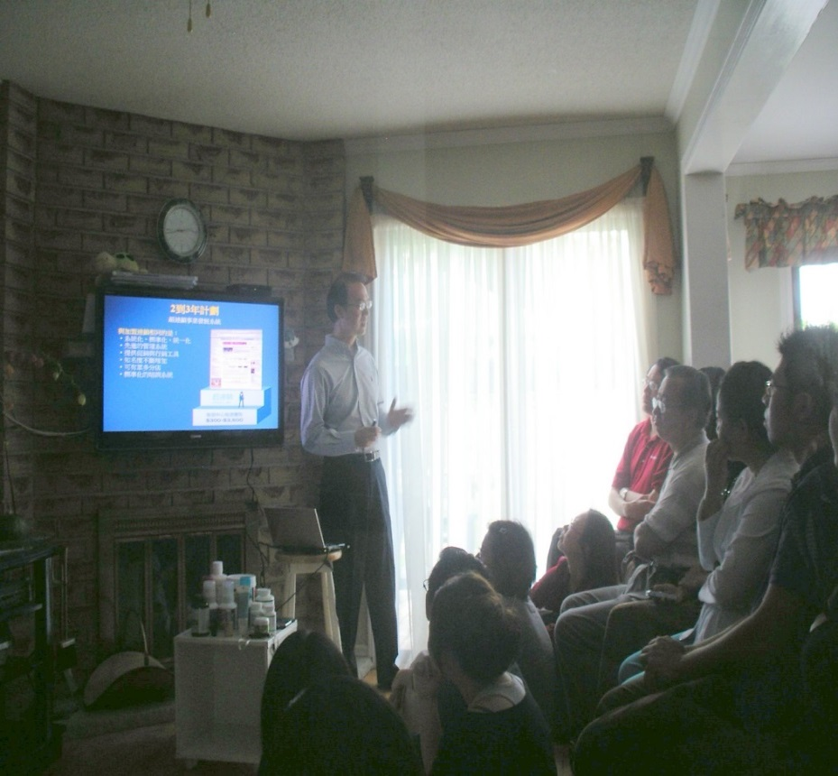
加拿大 Canada

Slide 23
台灣 Taiwan

Slide 24
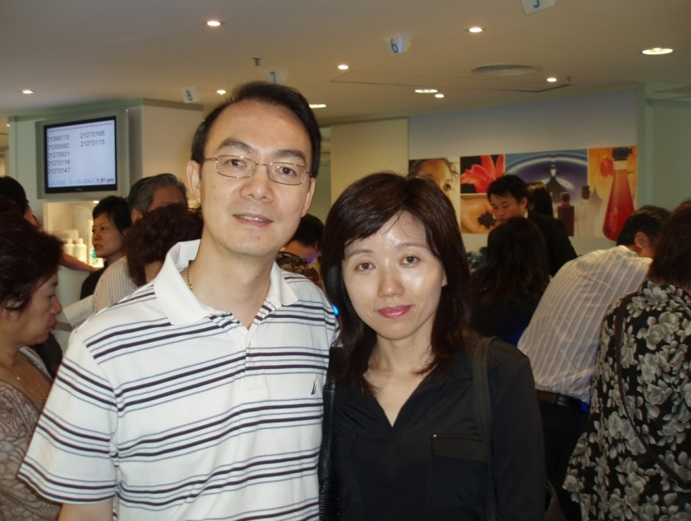
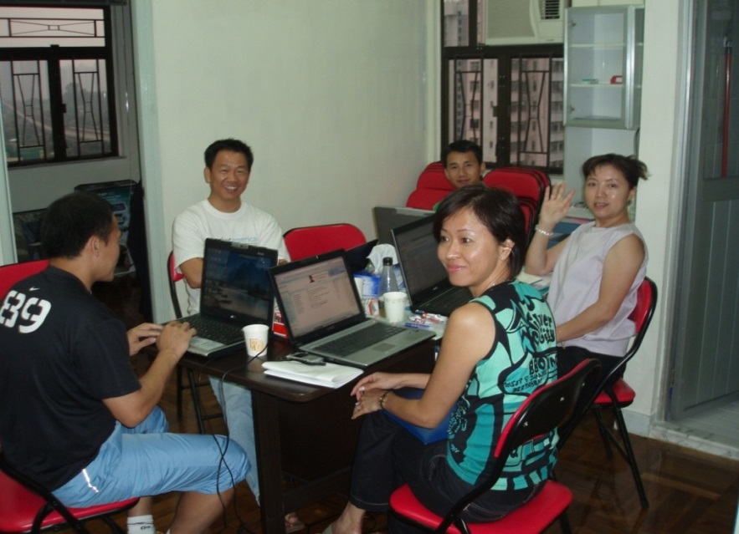
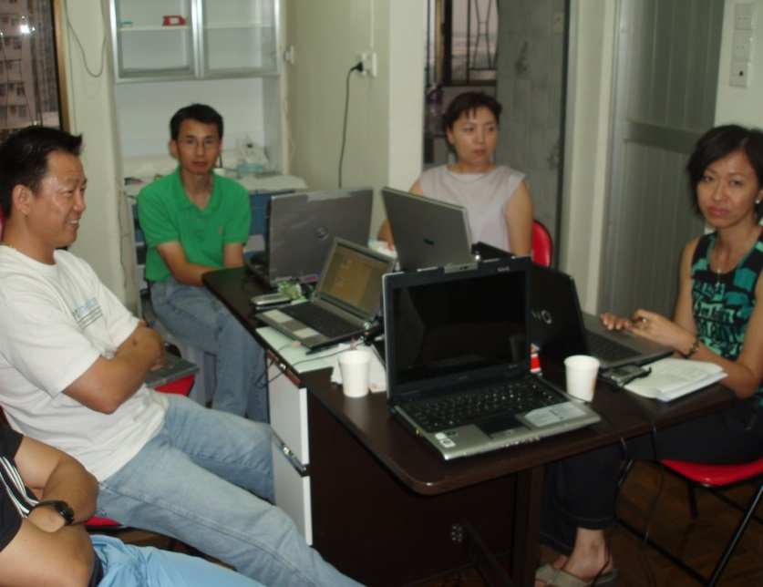
香港 Hong Kong

Slide 25
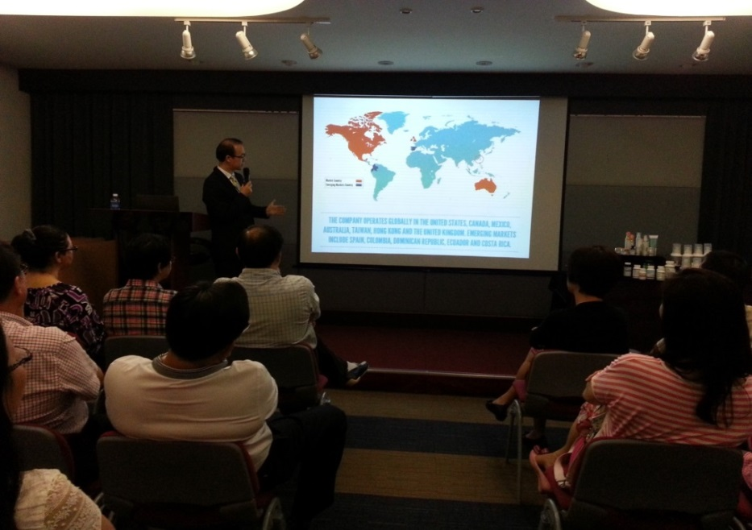
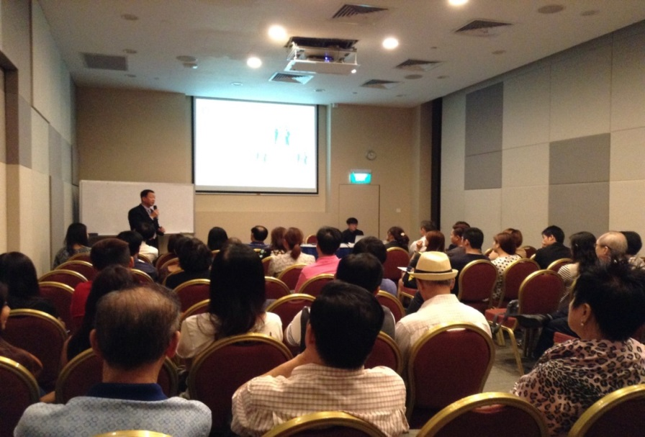
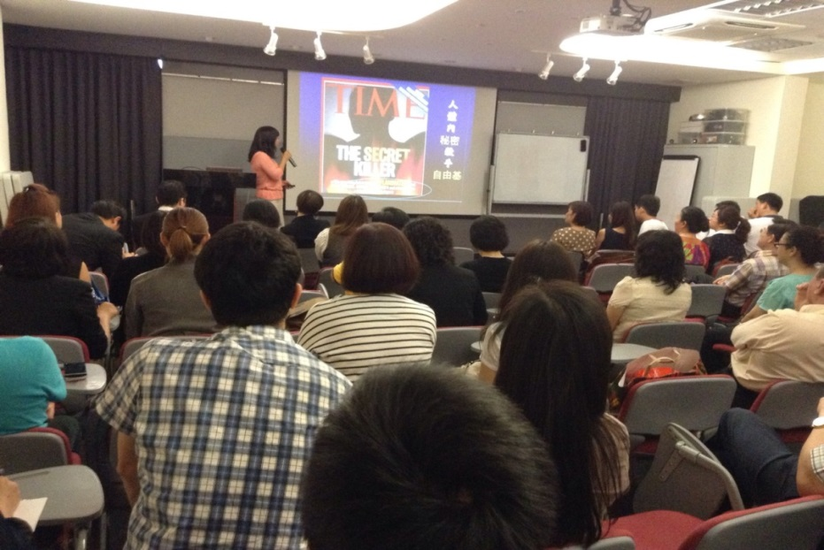
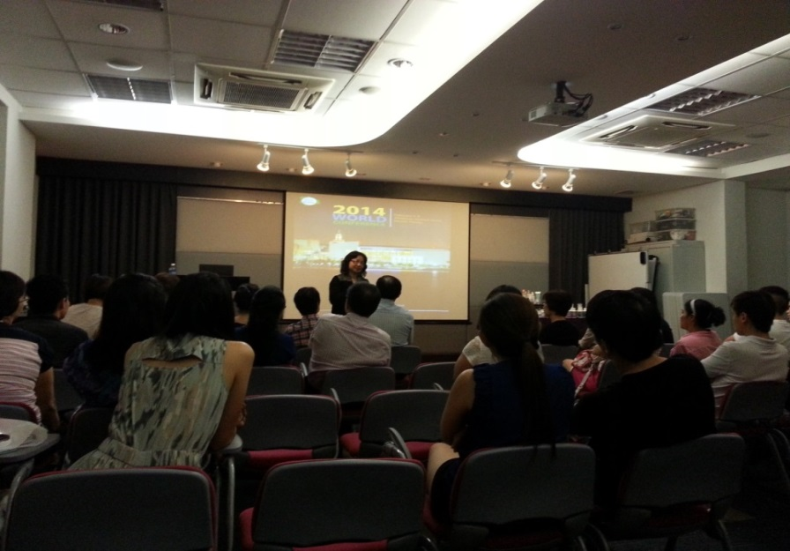
新加坡 Singapore

Slide 26
開拓國際市場
Develop an international business
開闊視野，豐富人生經驗 Broaden your horizon, enrich life experience
與成功人士和各地超連鎖™店主深入交流Contact with the successful people and UFOs around
磨鍊成長最快最好途徑之一 One of the best and the fastest ways to grow
Lots of fun!

Slide 27
開拓國際市場經歷 Experiences in developing international business
2002: Market Australia Open –
Professional Cord. to National Supervising Cord.
2005: Market Taiwan Open –
Director to Executive Director
2007: Market Hong Kong Open –
Executive Director to Field Vice President (FVP)
2014: Market Singapore Open –
FVP to Exe. FVP (goal)

Slide 28
Believe the Unbelievable
樹立信心，堅定信念
夢想家 >>>> 實踐家

Slide 29
勇敢追尋國際團隊夢想
全力以赴 夢想起飛
Just do it
Notes:
讓人們不討厭你 人們就會喜歡你
善用時間 分享學習教育改變我就是最好的見證
連續習慣21天養成增加新名單
就會產生吸引力法則 就會有人主動靠近我們
給予我們名單
每天執行並表格化 實際執行落實化
主動關心人 問候 打招呼 揪團購
買東西拿名片 要LINE 搖微信
從關心的人當中邀約見面
與朋友喝下午茶吃飯
中午休息與同事聊天
早晚左右鄰居談八卦
增加兩個新名單 透過朋友介紹
習慣與身邊的每一個人say hi 及讚美

Slide 30
在亞太區的年會再見 See You at Annual Conventions in Asia Pacific Region

